Slide 1



NIRAKULA TECHNOLGIES PVT.LTD
PRESENTS
SPT(Student Payment Tracker)

Slide 2
PROBLEM STATEMENT
I saw that in account section when we are supposed to submit the payment proof to clerks they accept and it takes at least two days to update and display the remaining amount to the student .
One of my classmate Arun submitted the proof 7 times to clerks , HOD and class InCharge as well but his payment is not updated till semester end exam came .
We understand that it is very tough for clerks to update thousands of records manually .

Slide 3


SOLUTION
Our “ SPT “ i.e Student Payment Tracker , is able to automatically update the remaining amount of student just by submitting a form on student page with necessary details . Here no requirement of manual updation as well as no need to physically come to college and submit the hard copy .

Slide 4


FEATURES

Slide 5
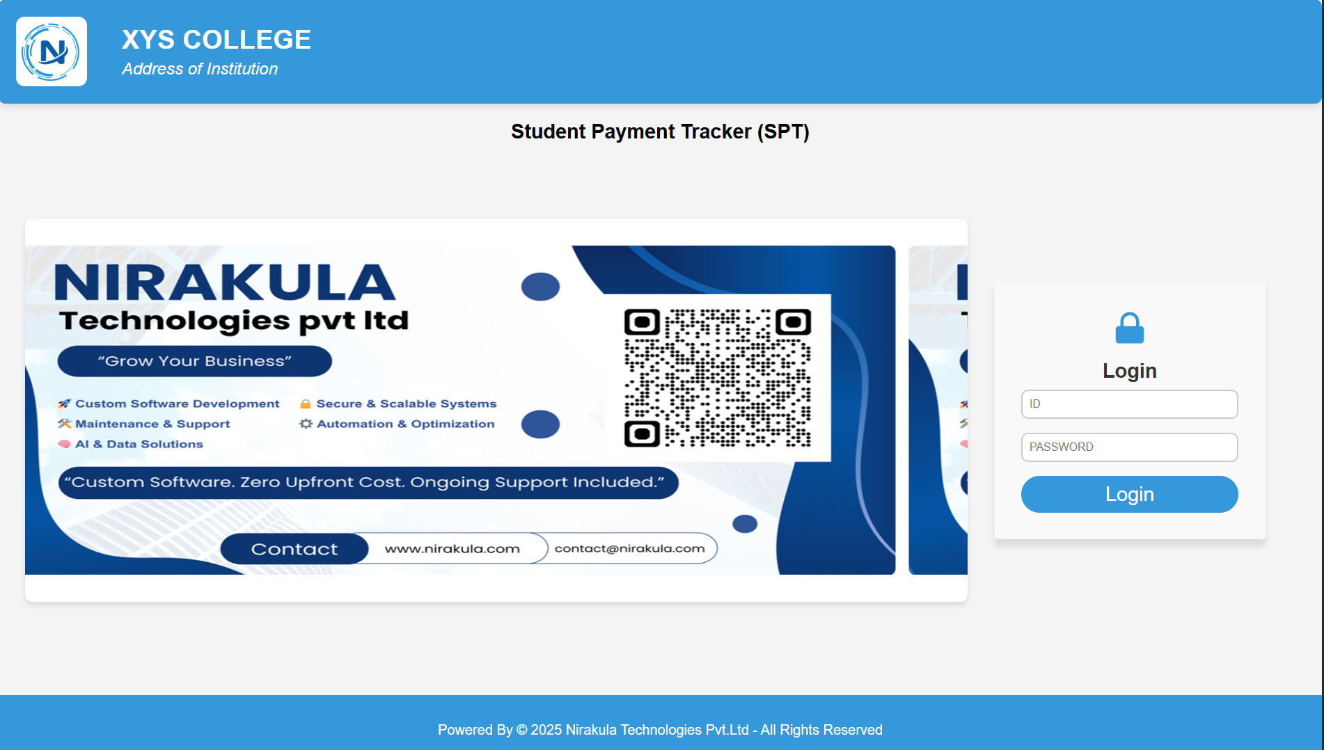
1 . LOGIN PAGE
Experience seamless access with our single-login system, designed to serve multiple types of users efficiently. Whether you're a student, faculty, or administrative staff, log in securely to access personalized dashboards and features.

Slide 6
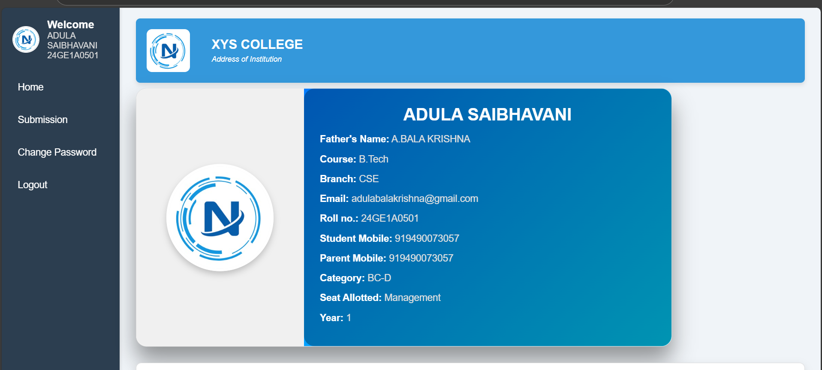
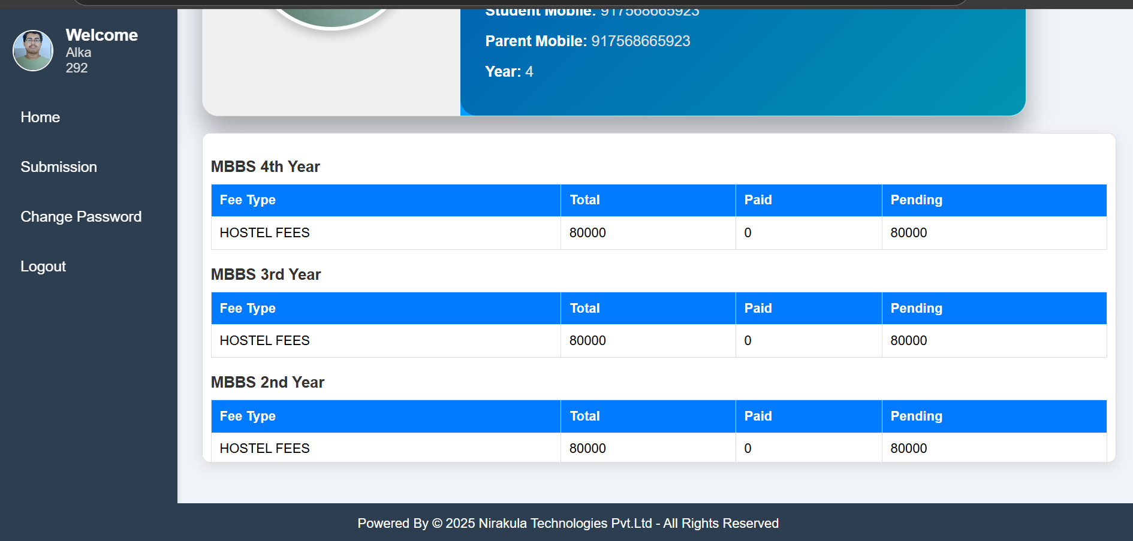
2 . STUDENT LOGIN :
-> student card , where student details are mentioned , with the photo at top left corner .
-> student fee summary , so that they can see how much amount they have to pay

Slide 7
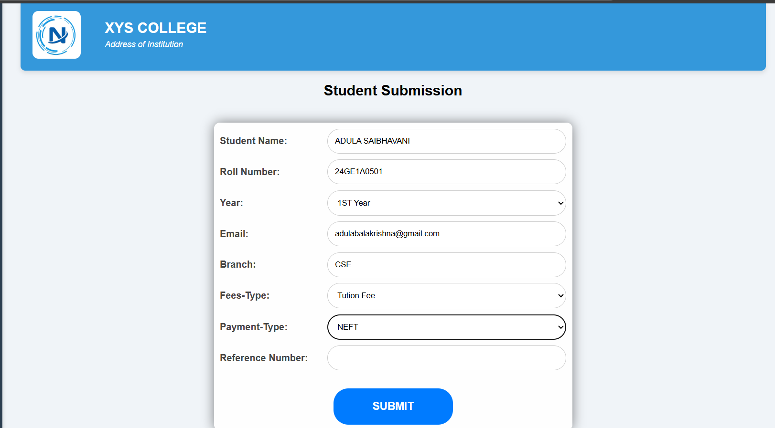
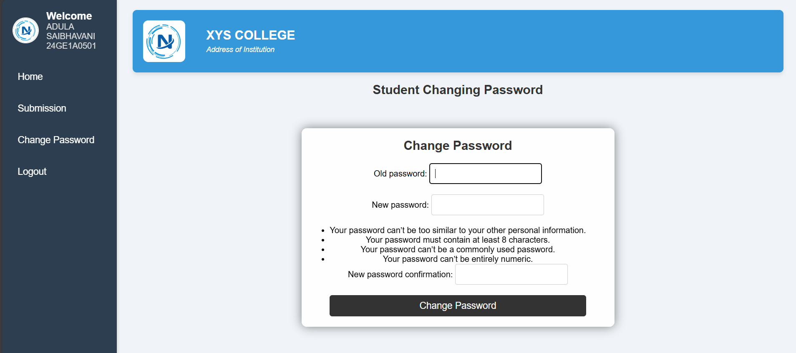
-> submission form , where student need to fill necessary details
-> changing password facility so that they can secure their page .

Slide 8
-> Student submission form :
This form consists of autofilling some details of students like Name , Roll no. , Category , Email .
Others are choosed by student itself like Year , Fees - Type ( Hostel , Tution , miscellaneous , Transport ) , Payment - Type ( UPI , RTGS , NEFT) and most important Reference number ( UPI 12 digit TID , NEFT no. , RTGS no. ) .
This software is equipped with one time use of reference number although we are uploading same account statement again and again , it will not used by anyone again .

Slide 9

-> On the spot Info to student regarding their submission whether their dues are cleared or now how many are pending .

Slide 10
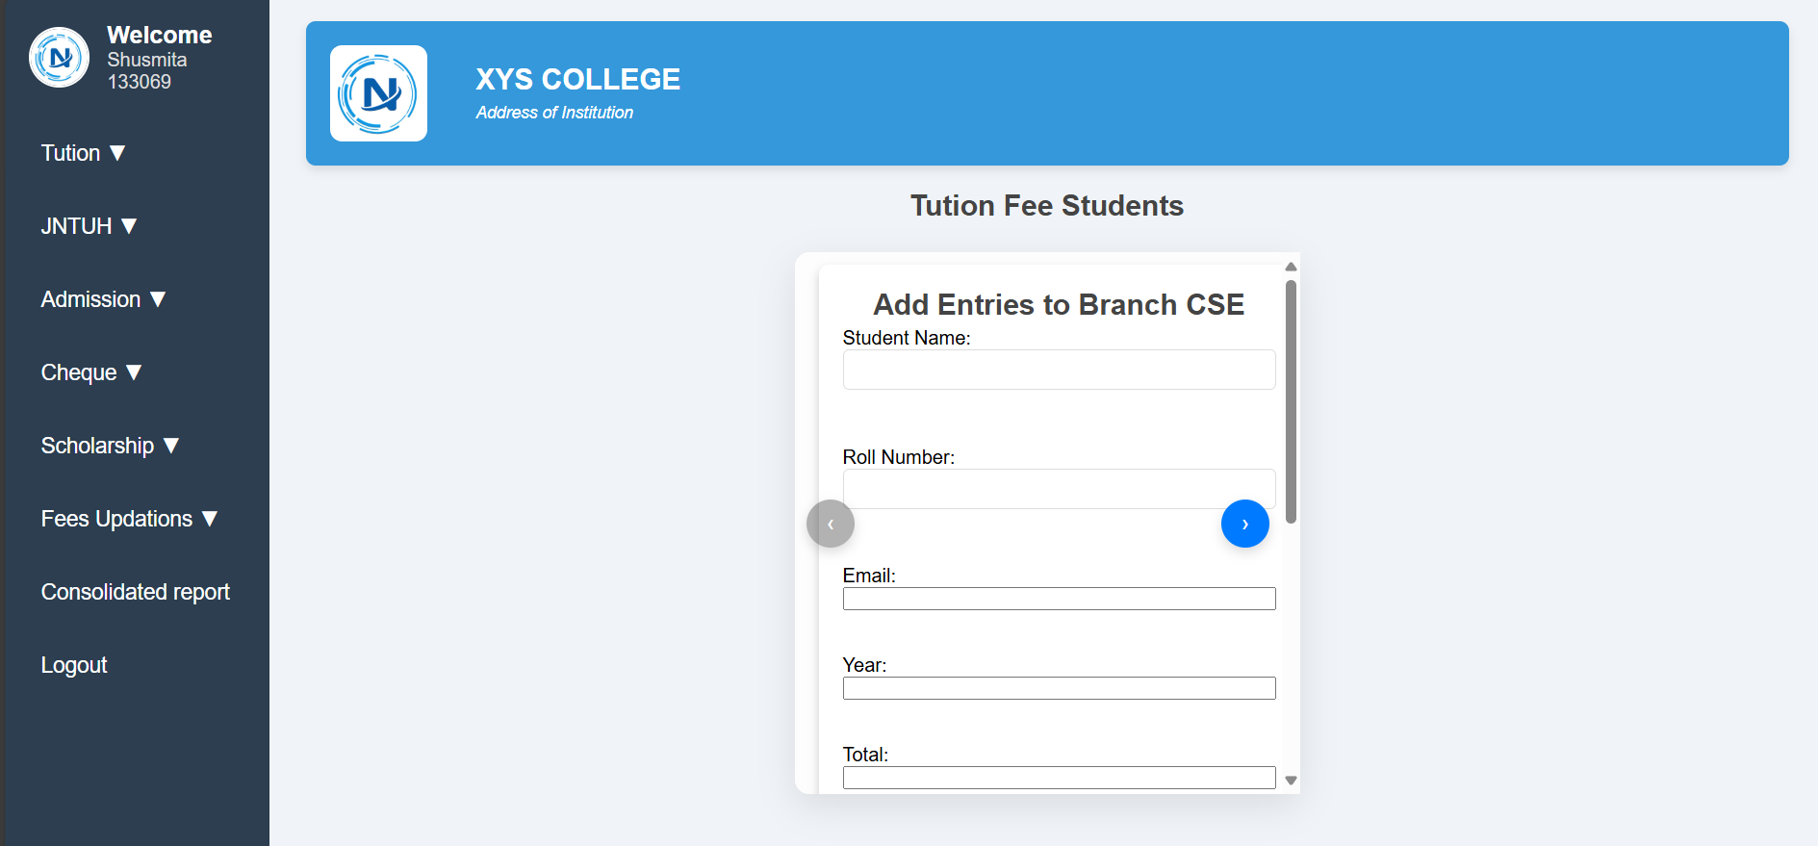
3 . STAFF LOGIN :
3.1 Tution Fee Staff : It consists tution ,JNTUH , Admission, Scholarship fee monitoring . They have only facilities of viewing fees report . They are not able to manipulate any data , but they can update the fees of particular student from Fees Updations section in nav bar incase student forgot to update through his portal

Slide 11
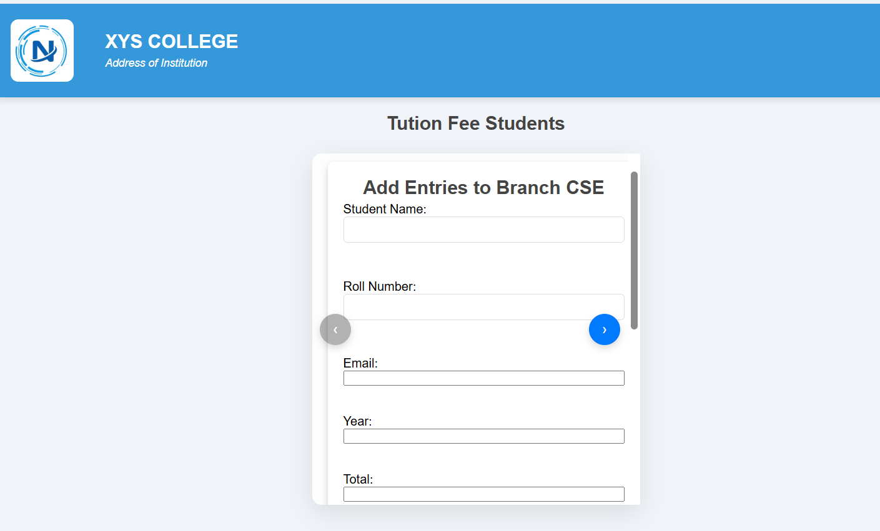
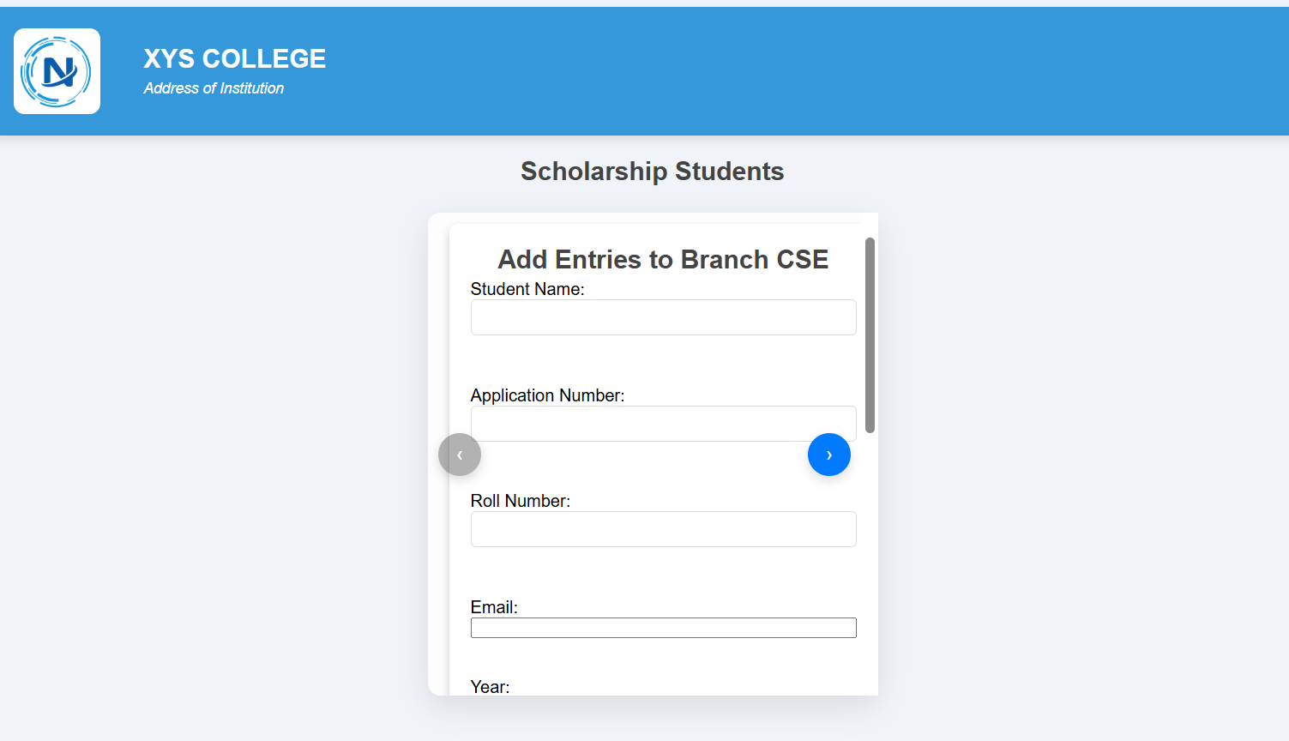
They can add tution , Admission , JNTUH, Scholarship fees student data (which includes their fees to be paid per year) , either by single entry or uploading excel sheet with bulk entries . Their carousels are placed which can be swiped and different Branch option will appear .

Slide 12
DATABASE
They can see the database using filters like Branch(CSM,CSE,ECE etc) , Class( 1st year , 2nd ,3rd ,4th , ALL) , Status(Pending , Completed) .
The button Save As Pdf will create an pdf of that record and can be easily downloaded through browser .
In database the phone numbers of students are the links which send an SMS on that number , which includes that student fees data .
For ease at he bottom of table their is one button Message All which automatically send SMS to all numbers present in table.

Slide 13

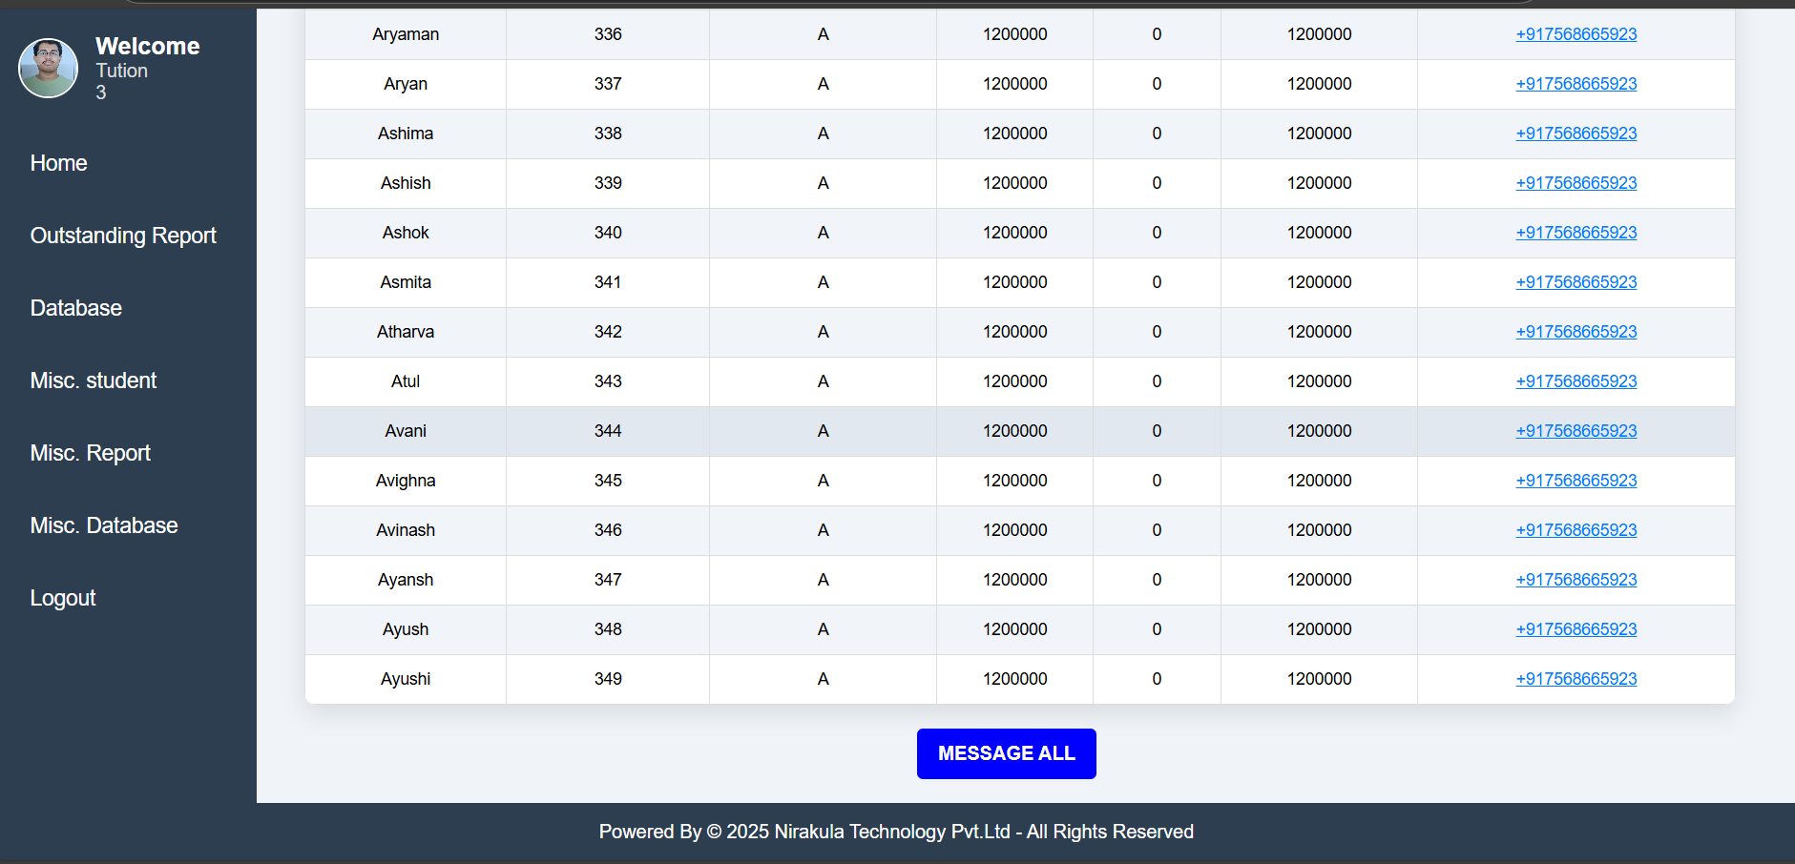
DATABASE

Slide 14
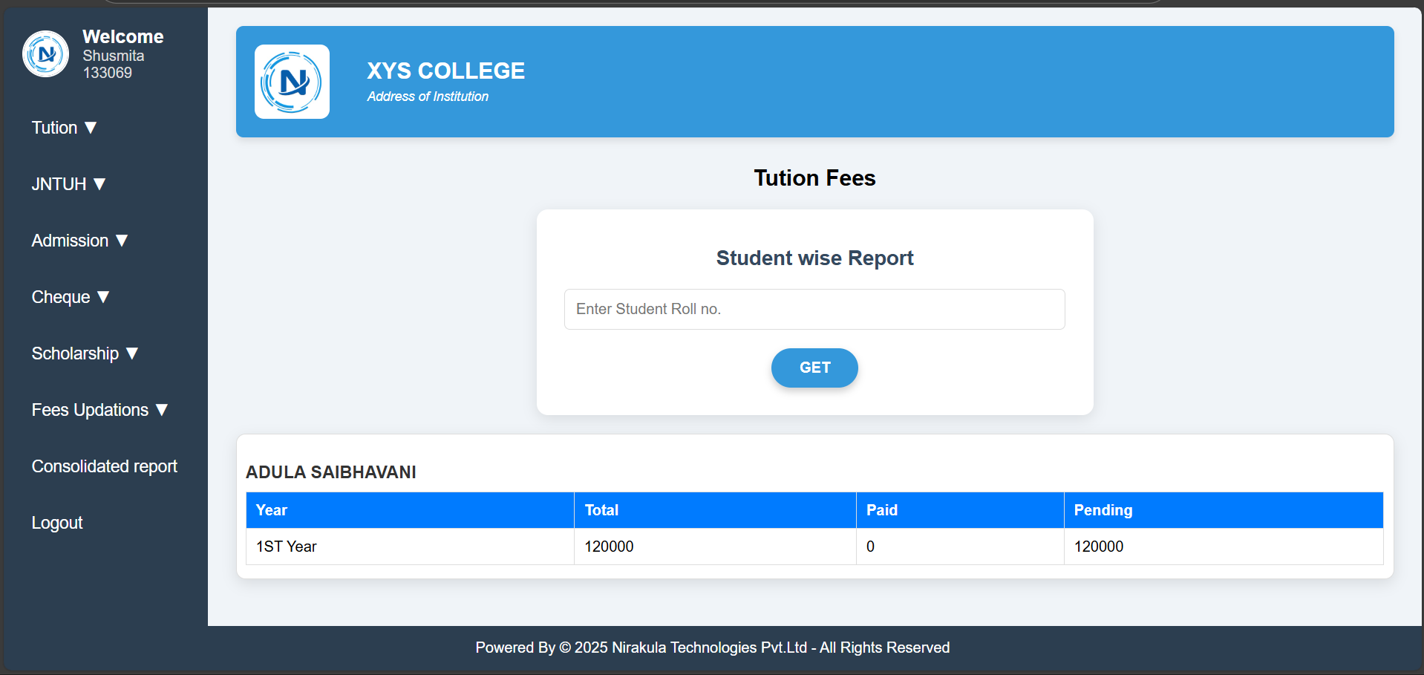
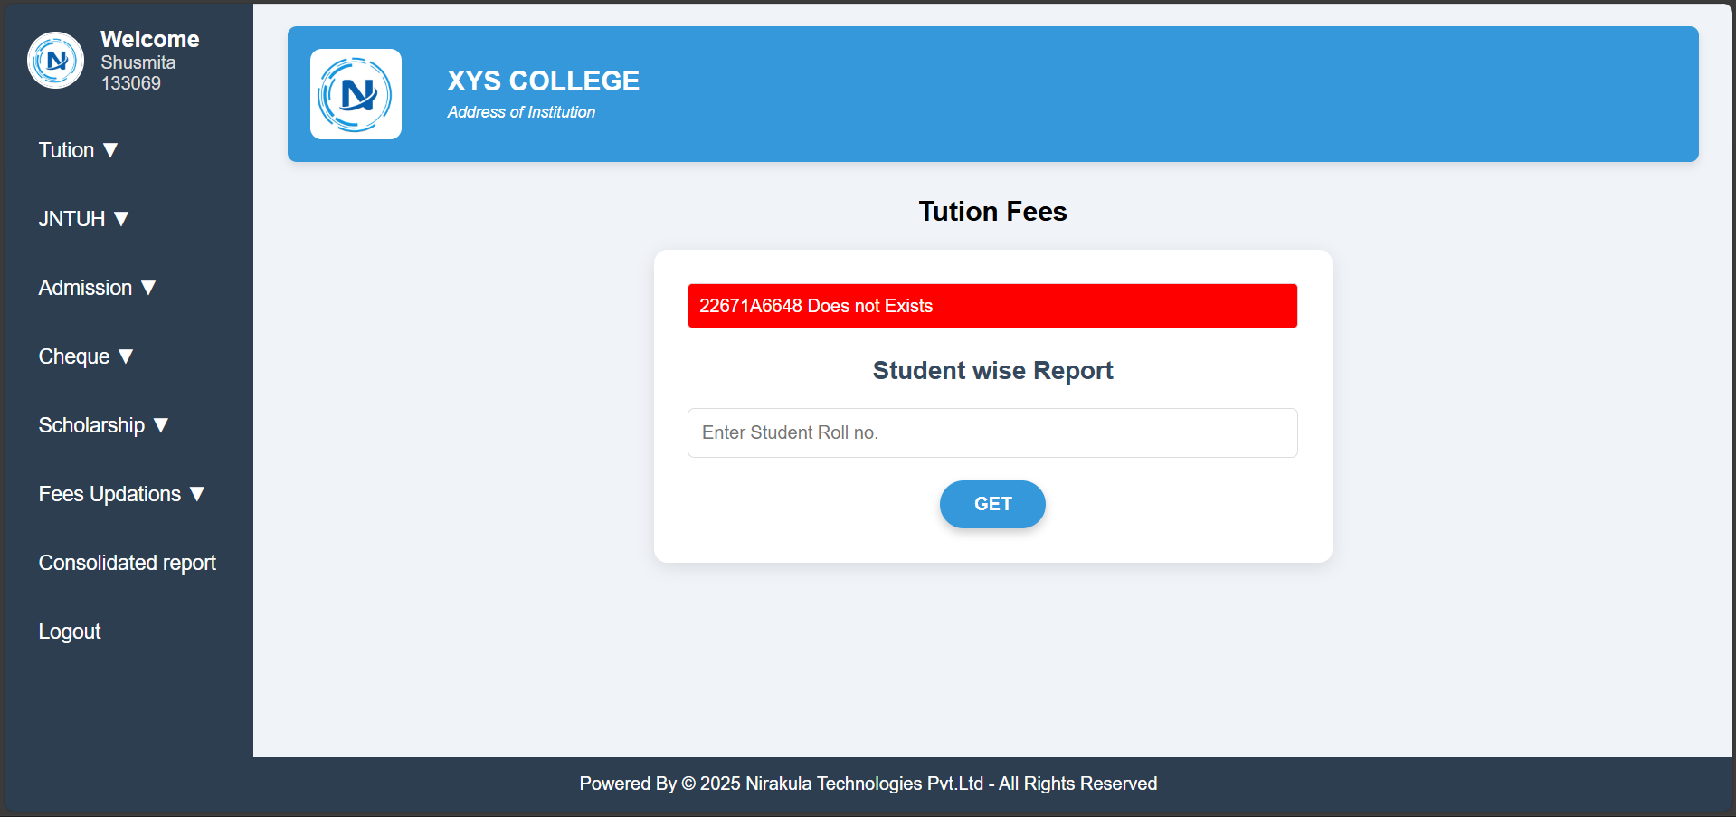
Student wise ReportReport
We have Student wise report generator for each type like tution, Admission , Transport , Hostel , JNTUH, Scholarship etc . Which can present whole history of the payments of that student till the date with the years .
It have multiple checks of student identity wheather it exists or not or if exists his/her data exists or not.

Slide 15
3.2 Hostel Staff :
Similar like Tution staff , Hostel staff have same features like only viewing and generating or downloading data in pdf format . They can also add hostel students category wise either by single entry or in bulk using excel . They can also download database or send SMS to parents regarding the fees . They can also generate student wise report .
3.3 Transport Staff :
Similar like Tution staff , Transport staff have same features like only viewing and generating or downloading data in pdf format . They can also add Transport students category wise either by single entry or in bulk using excel . They can also download database or send SMS to parents regarding the fees . They can also generate student wise report .

Slide 16
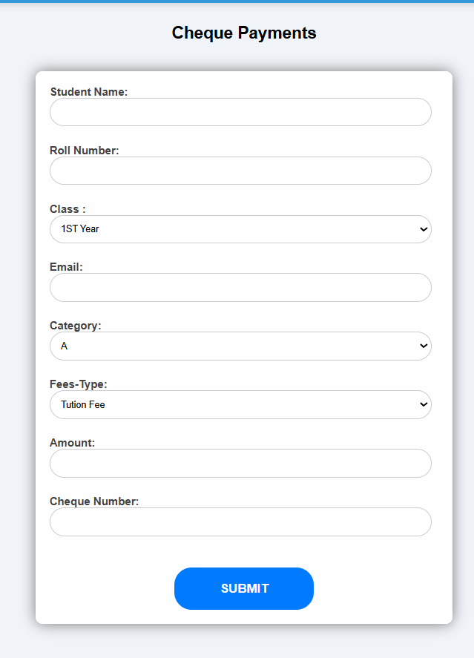
3.4 Cheque Staff :
Here , staff can manage cheque payments submitted by student . When student came with the cheque of payments , staff can enter details in the form .
It will automatically check the duplicity of cheque and if cheque is valid then the amount w.r.t details it automatically update the student fees .
Staff can also check the particular student cheque history year wise , also they can analyze the data in database section using different filters

Slide 17
DATABASE
They can see the database using filters like Branch(CSM,CSE,ECE etc) , Class( 1st year , 2nd ,3rd ,4th , ALL) , Fees-Type(Tution , JNTUH , Hostel , Transport) ,
Amount( lt_50,000 , gt_100000 ) .
The button Save As Pdf will create an pdf of that record and can be easily downloaded through browser .
In database the phone numbers of students are not the links they cann’t send an SMS on that number.
STUDENT WISE REPORT
It provide the info of cheque submitted by a particular student with the amount date submitted etc , with year wise like in 1st year 2 cheques are submitted in 2nd year 4 cheques are submitted etc.

Slide 18
4 . ADMIN LOGIN :
It will be the main supervisor of all authentications for student as well as staff and the required details like name , id , image , email , passwords etc is managed by Admin . It has a main feature of generating consolidated report session wise with multiple filters like :
1 . seat allotment wise (like scholarship holder, management etc)
2 . Branch wise (like CSE,CSM etc)
3 . Year wise
4 . Fees type wise (Like 1st , 2nd , 3rd etc)

Slide 19
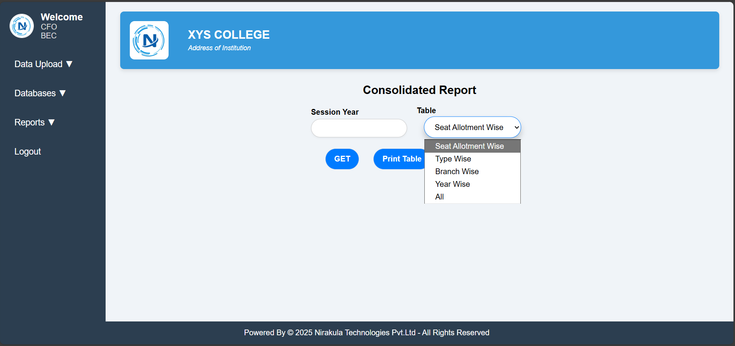

Slide 20
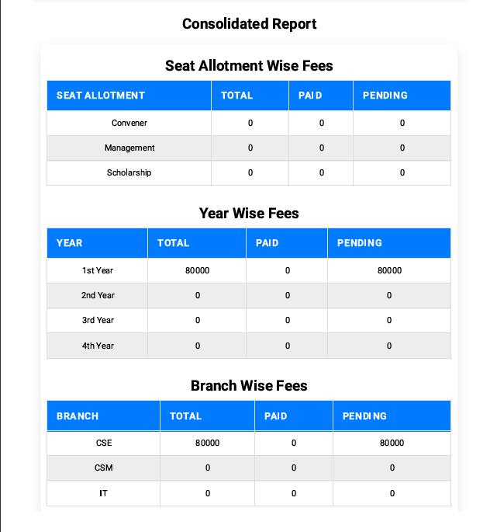
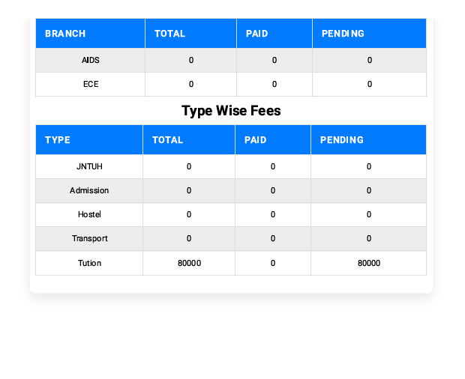
Consolidated Report Example :

Slide 21
THAT’S ALL , YES IT’S FULLY CUSTOMIZABLE FROM USER INTERFACE TILL FEATURES .

Slide 22


CONTACT US
founder@nirakula.com
www.nirakula.com

Slide 23
THANK YOU

